Slide 1
The Rady School of Management
MGT 167 • Winter 2024
Social Entrepreneurship: Doing Well by Doing Good
Wednesday, Feb. 7

Slide 2

Professor’s Office Hours
Before class at 10:20am in Green room
Rady Undergrad lobby conference room
After class MW at 12:30 in lecture hall
(except on days of guest speaker Brown Bags)
On request

Slide 3

Feedback from Monday, Feb 5
Outstanding Climate Change presentation! +++++++++++++++++++++++
“Informative, inspiring, moving, amazing, great!”
I liked hearing personal stories as it truly helps me resonate with the passion more.
I learned what a food desert is. I learned about indicator species.
Climate Change has been my favorite presentation so far.
Bingo was SOOO FUNN !
Appreciate the guidance on the networking interview.
I didn’t notice the parallel between networking and the Generations assignment. I like the contrast between talking with someone you know well and someone you don’t know at all.
I really liked learning about fund raising.
Fund raising is difficult but increasingly important in entrepreneurship.
Valuable lesson today.
I was surprised that 70% of funds raised are from individuals.
How can I network with a CEO making a lot of $? Now I know!
I hope to be like MacKenzie Scott.

Slide 4
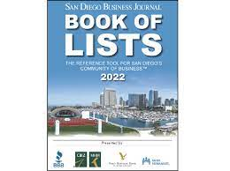
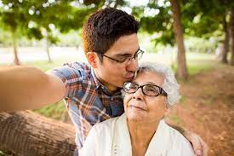
Feedback from Monday, Feb 5
The Book of Lists is really cool. Can’t wait to use it more.
Really interesting to go through the SDBJ Book of Lists.
Interesting how we can contact someone through
the Book of Lists.
People are very rich in this area.
I like how we went over the wealthy organizations and where they got their funding.
I learned about fundraising obstacles for social entrepreneurs and charities.
Fundraising part was very surprising and informative.
These fundraising tips are super useful. I am really bad about asking for money.
Helped me understand that you won’t get anything if you don’t ask.
The generational video was inspiring!

Slide 5
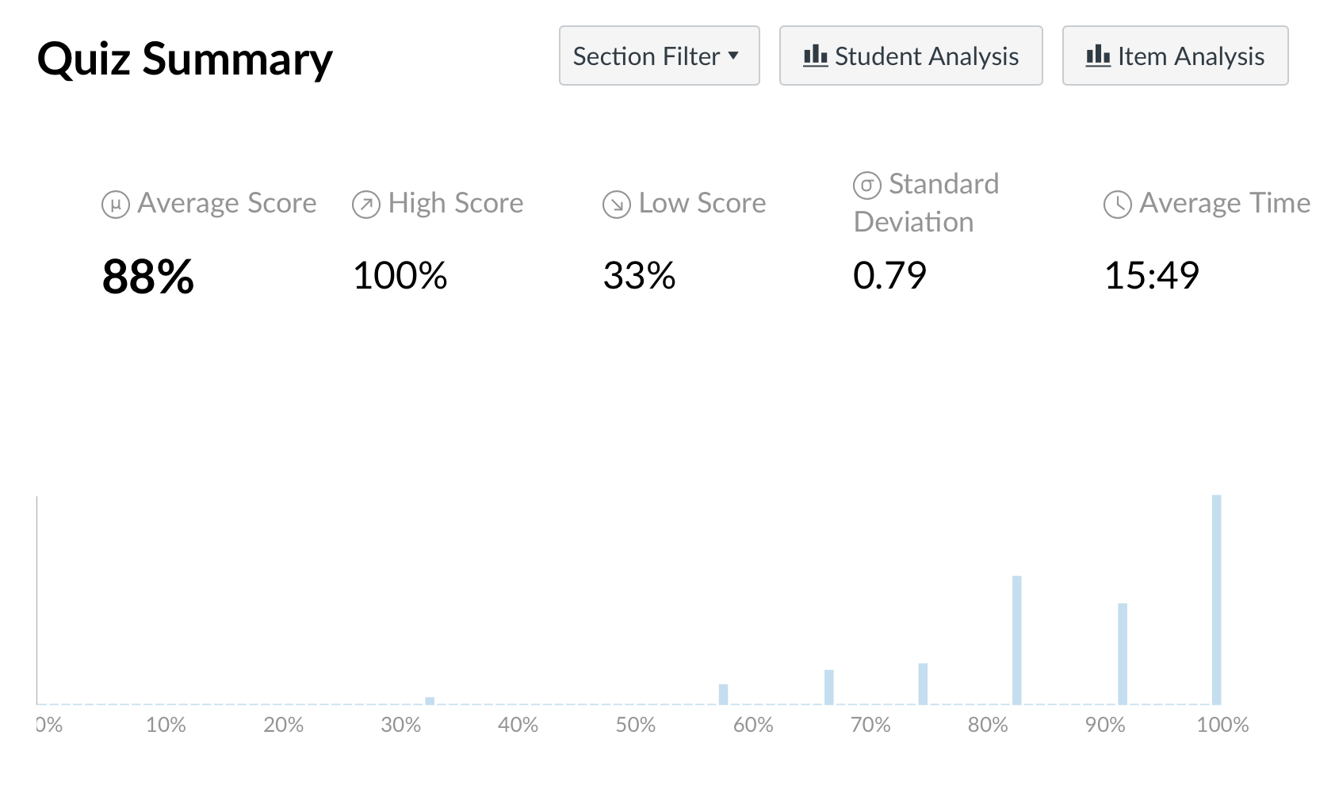
Q #2: Early returns

Slide 6
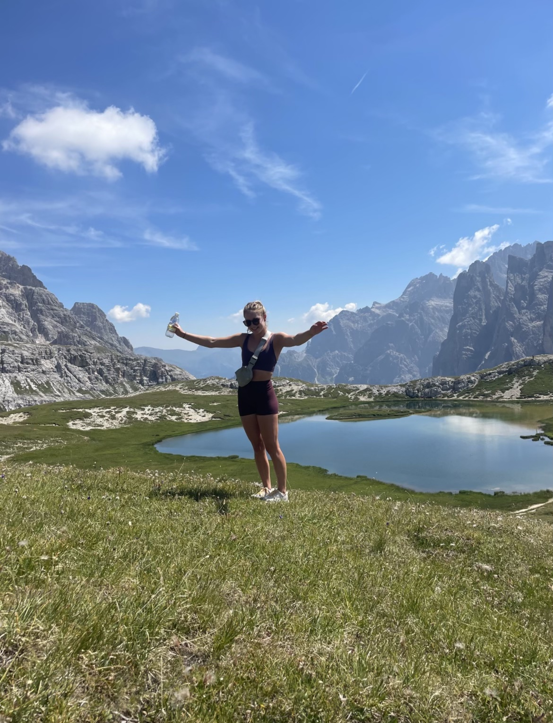
News of the Day Elsa Kurth

Slide 7
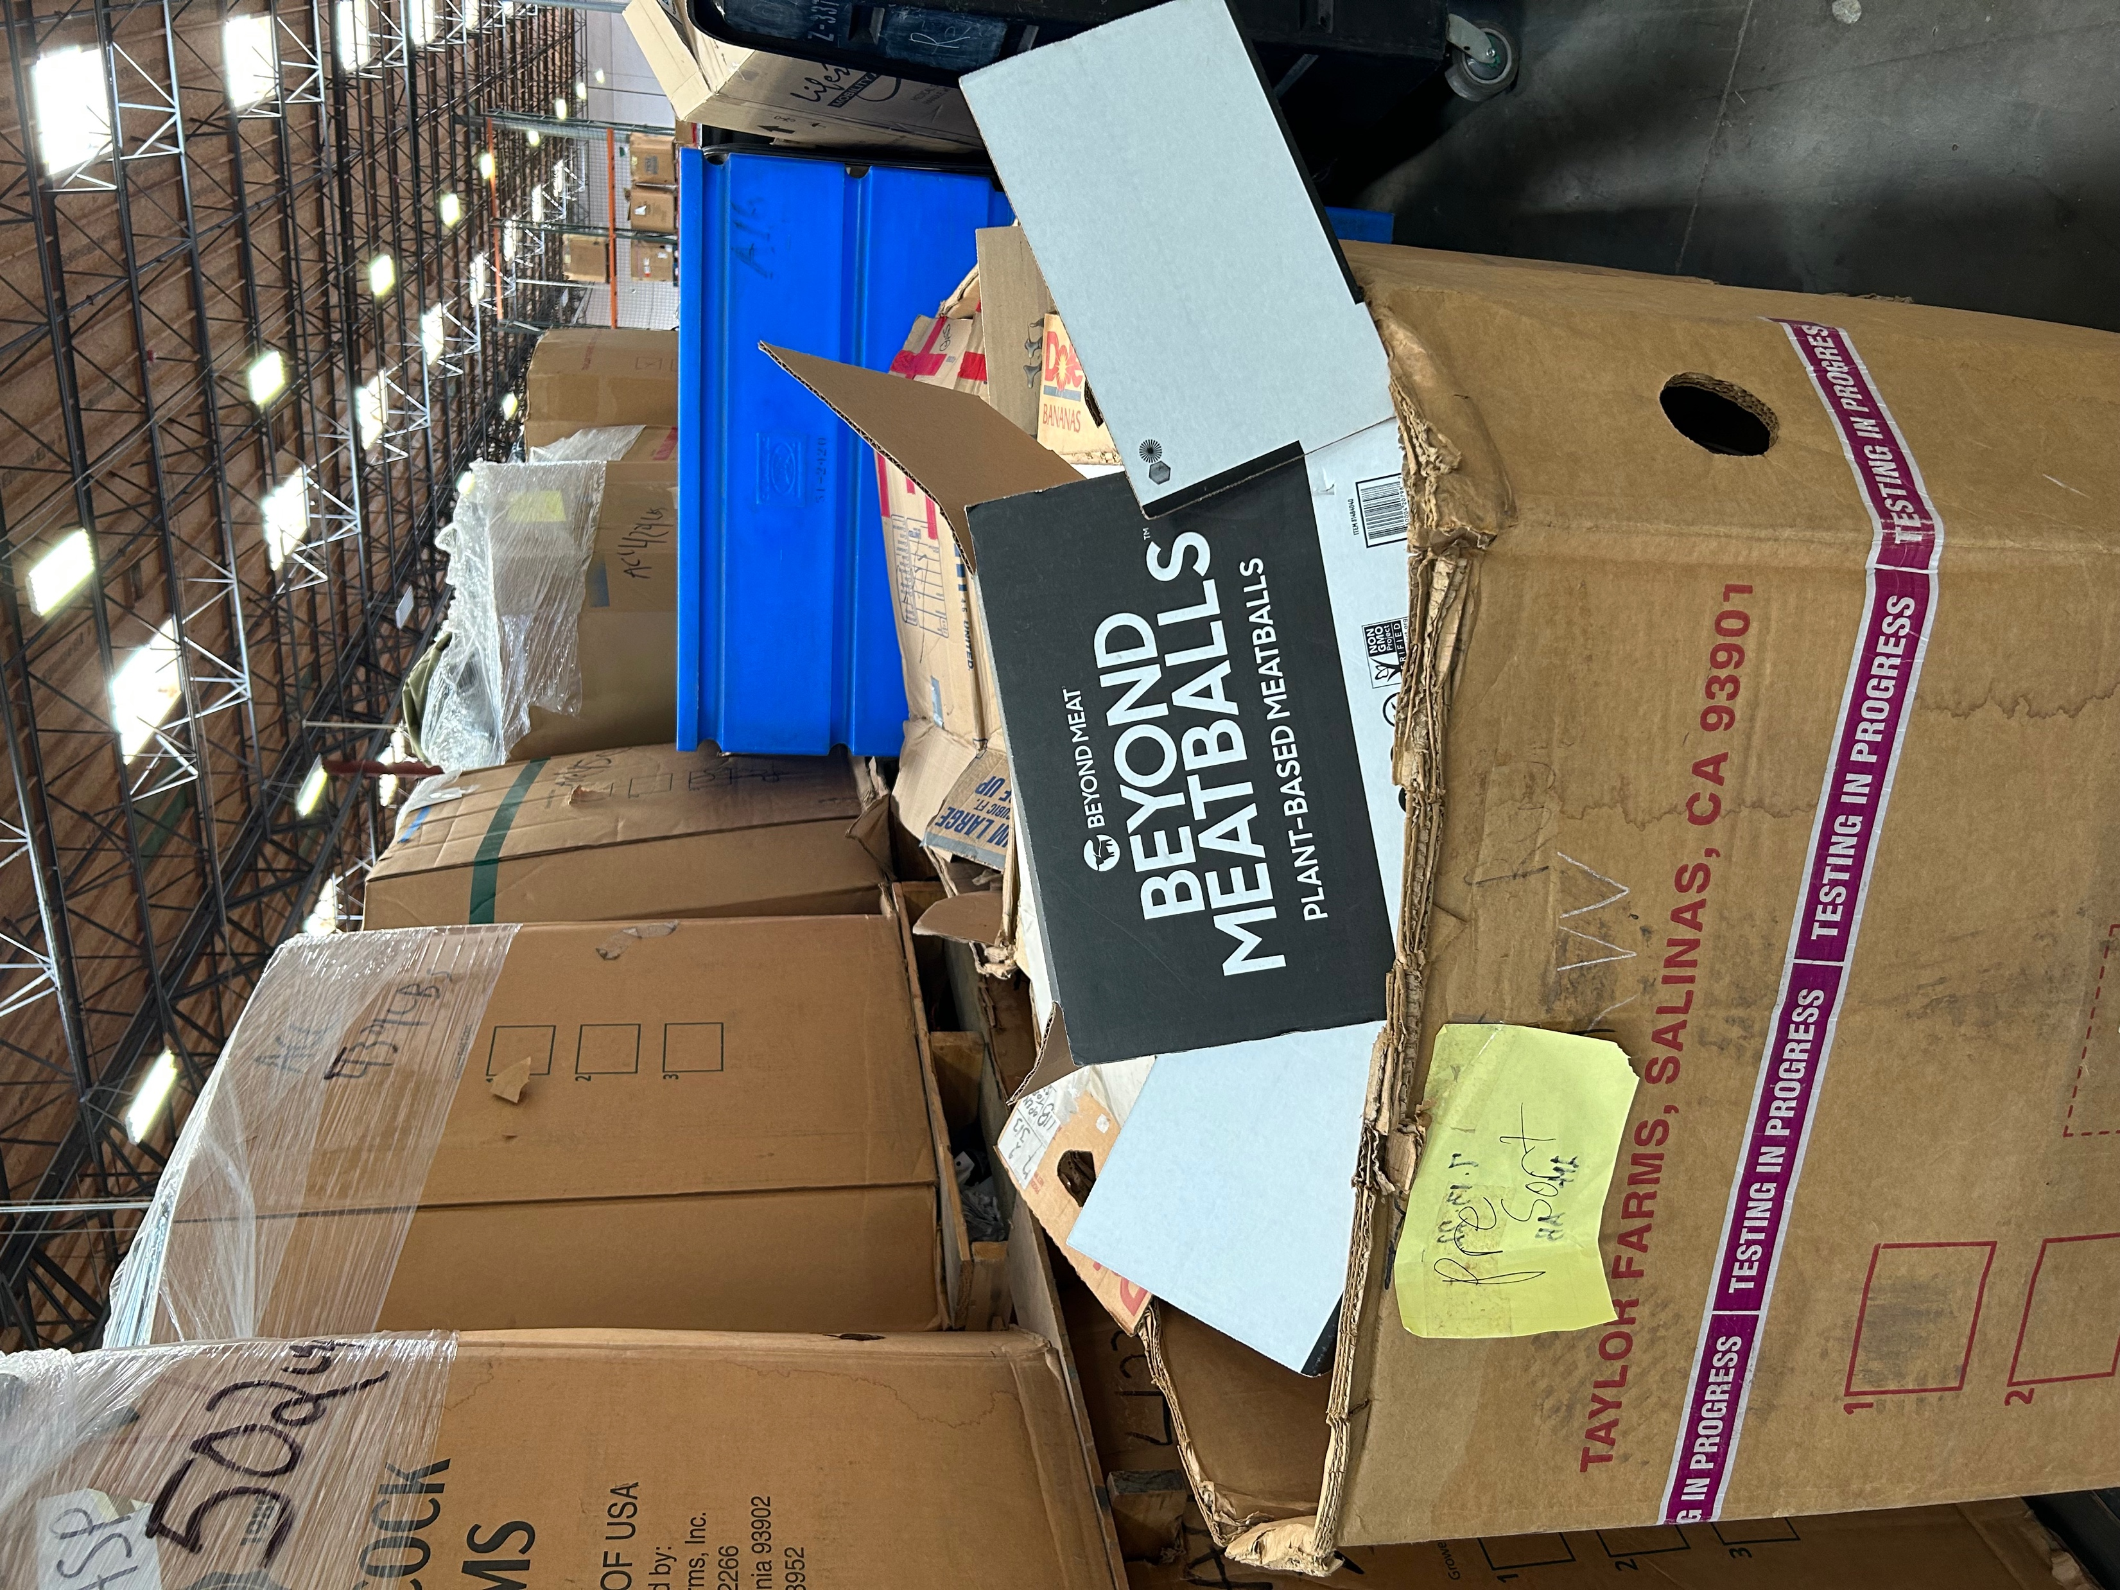

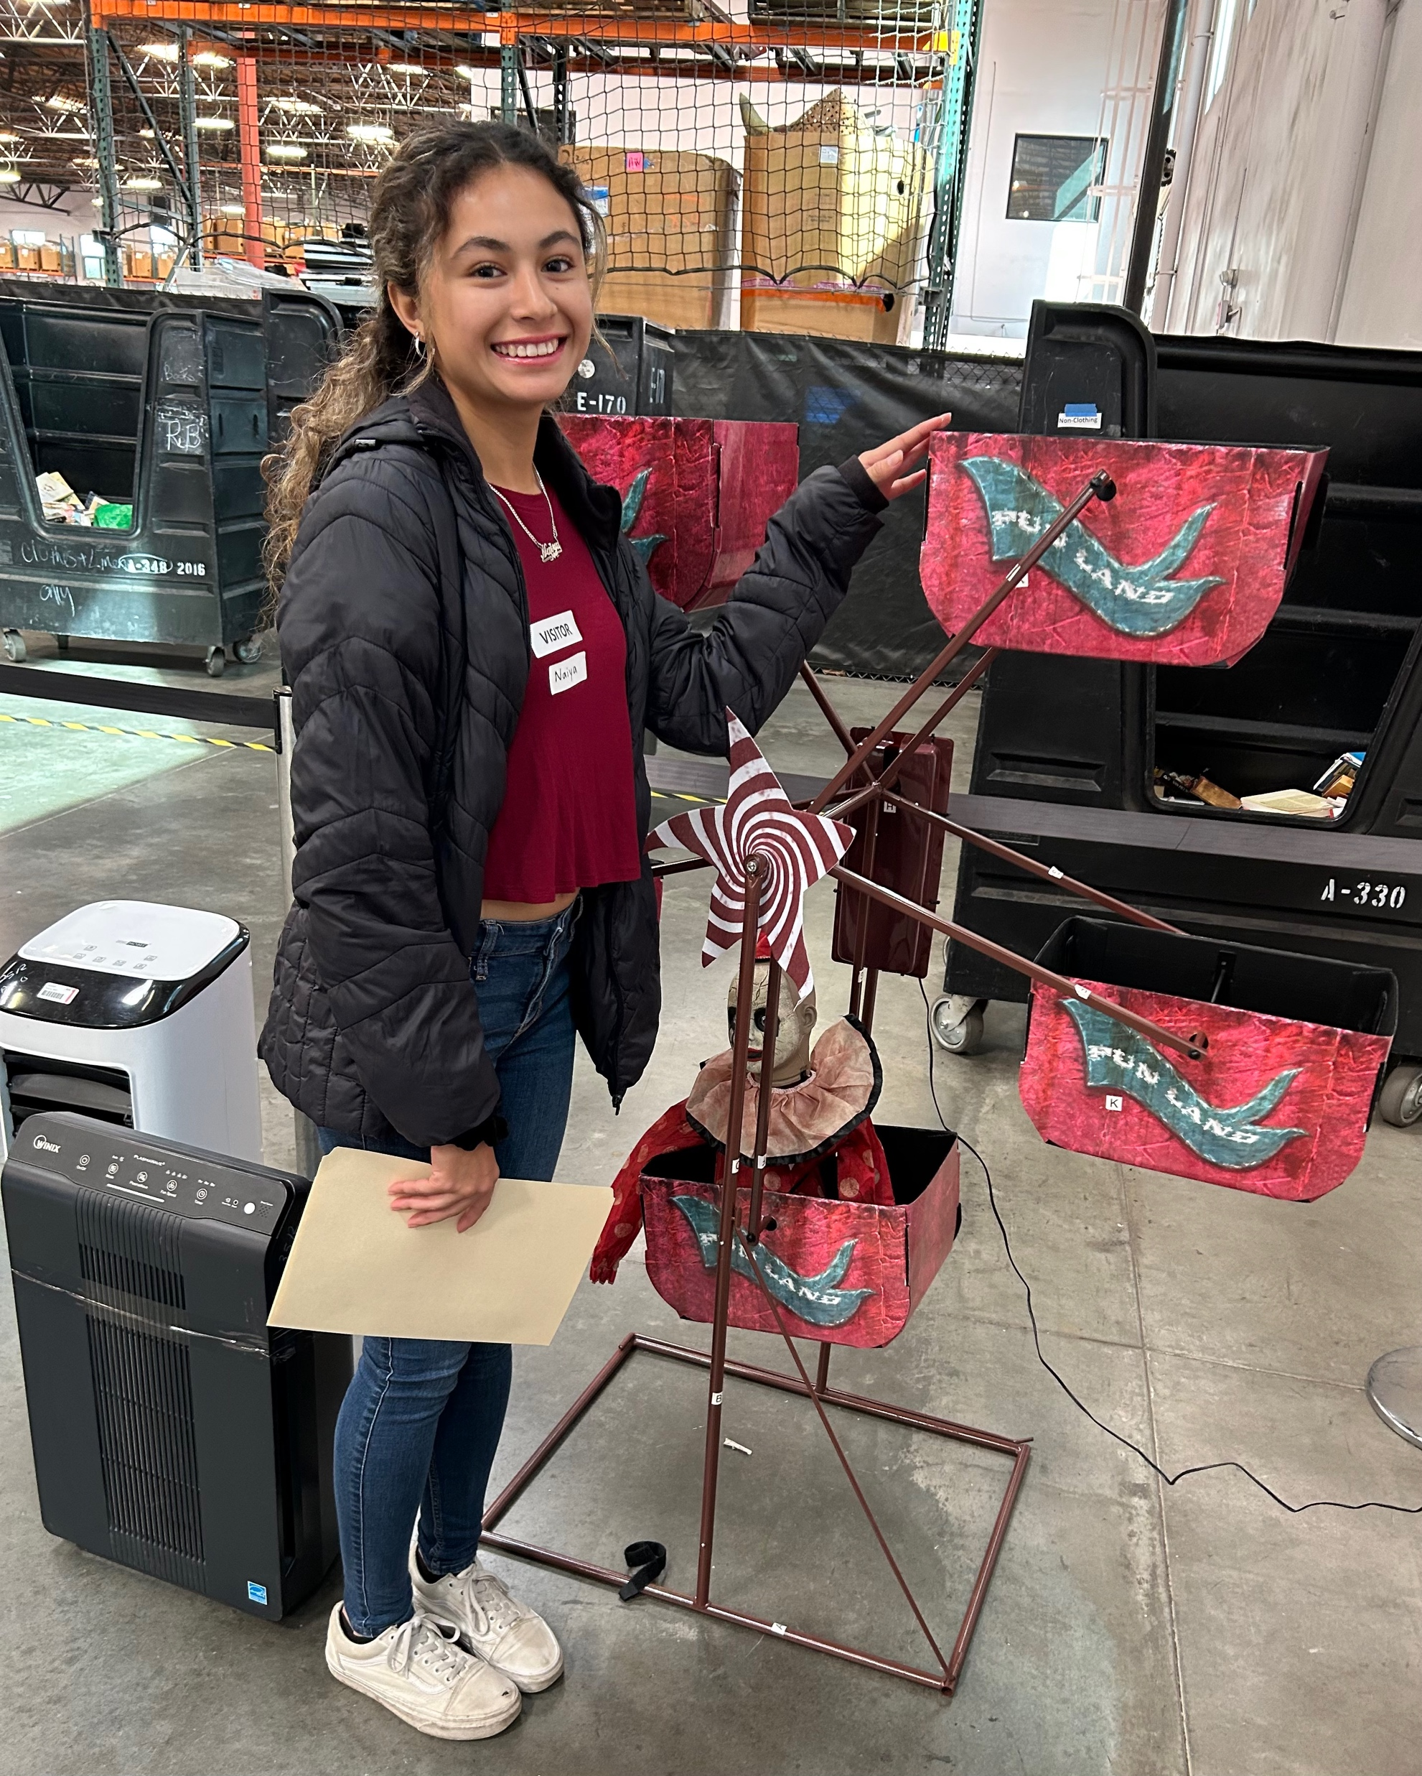
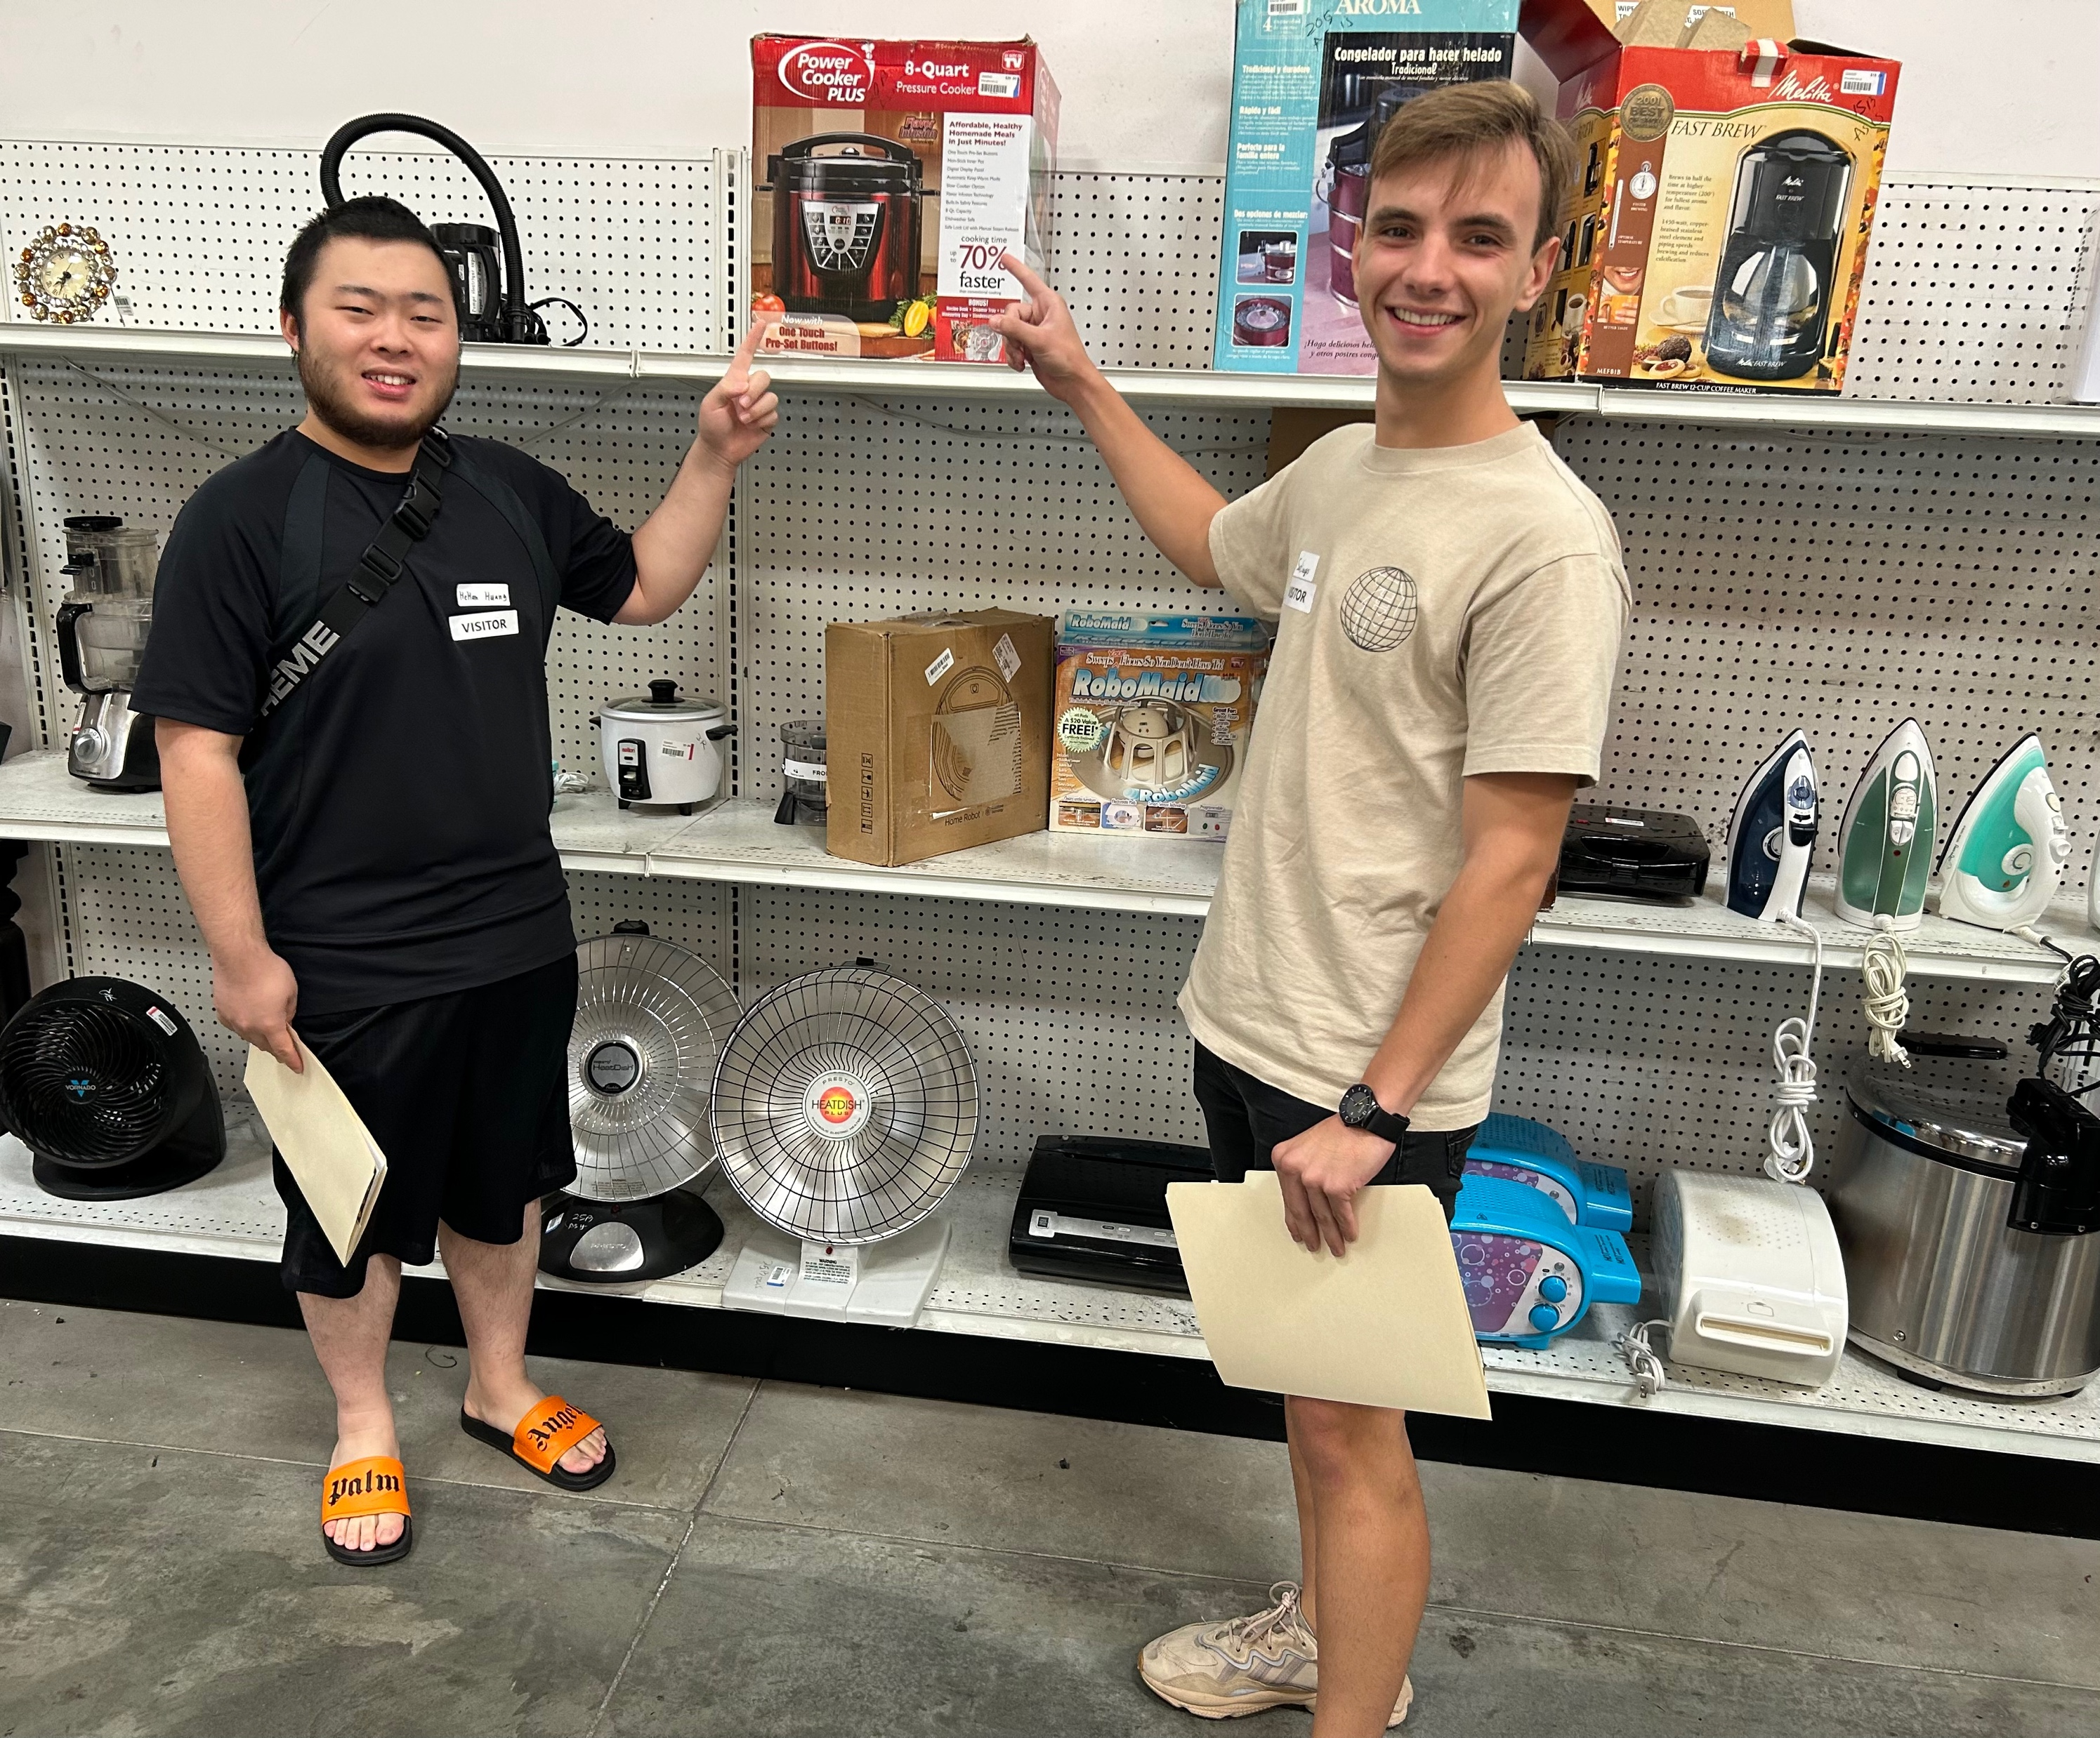
Optional Field trip to Goodwill Otay Mesa Saturday, 10 February at 10am 6655 Camino Maquiladora OK to bring friends Carpool

Slide 8

NFP stats
1.5 million nonprofit organizations in the United States.
Nonprofits employ 10% of the U.S. workforce (16.8 mil)
(DOD = 2.87 mil.)
Nonprofits employ 7.4% of the worldwide workforce.
5.7% of the United States GDP comes from nonprofits.
The total U.S. nonprofit annual revenue is $2.62 trillion.
64.4 mil Americans volunteer for a charitable cause.

Slide 9
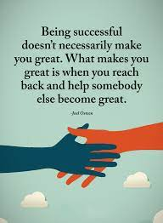
Interim Class Participation Grades posted next week
Grades are an indicator of your CP grade
“Temperature check” mid-term
Your own CP self-assessment due Mon. Mar 11 (optional)
A “interim” grades characterized by
Engagement in class, responses, formal QA for guest speakers using protocols
Participation in Office hours
Attendance, recorded by table tents
Leadership: Passion team captain, guest speaker host
Conscious Capitalism conference (Jan 17), Goodwill field trip (Feb 10)
Attendance at Brown bag lunches
Your grade will not go down
But you can improve your grade
If you earned an A, reach out
and help a classmate

Slide 10
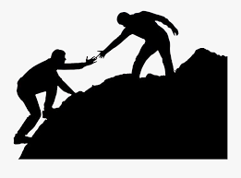
Class Participation 15% of grade

Slide 11
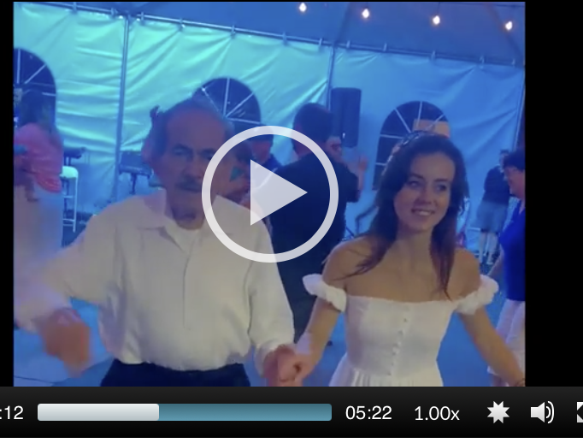
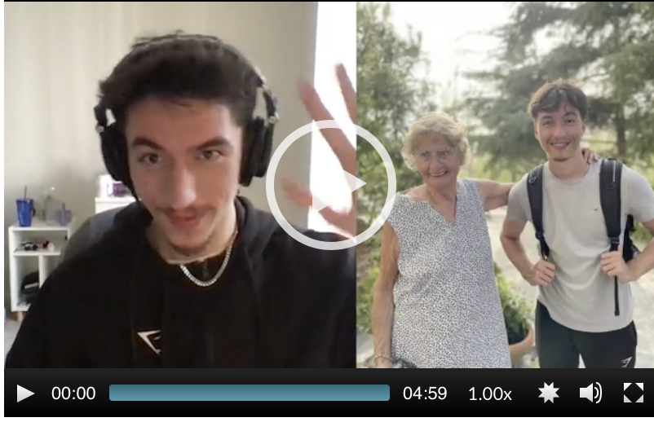
Generations Project in lieu of Final exam

Slide 12

Passion
Sports

Slide 13

The Rady School of Management
Fund Raising
Part 2

Slide 14
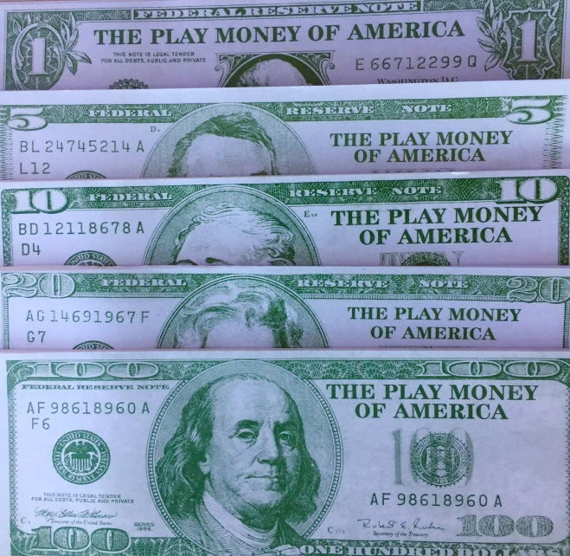
Social Entrepreneurship
You have…
Passion for doing well by doing good
Fundamentals of non-profits
Networking skills
Now what?
You need to raise money!

Slide 15
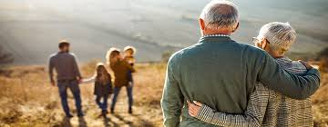
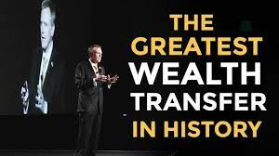
The Great Wealth Transfer

Slide 16
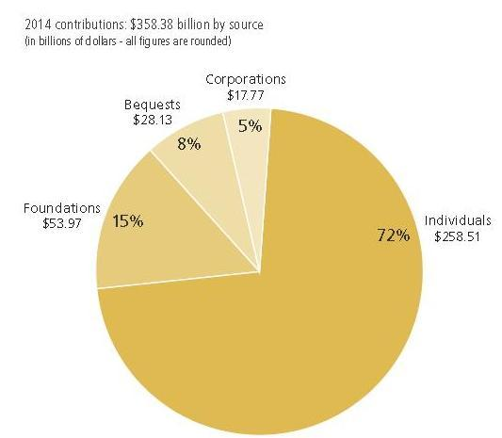
Fundraising: The Giving Pie

Slide 17

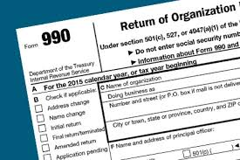
Fundraising: Resources
BoardSource
SD Business Journal Book of Lists
Chronicle of Philanthropy
Guidestar
Independent Sector
501(c)(3)’s Form 990
Indiana University, Stanford University
Local San Diego
USD Non-Profit Leadership
National University, Sanford Center
Non-Profit Management Solutions

Slide 18
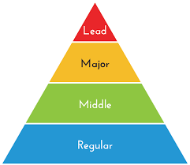
Fundraising: The Campaign Pyramid
Prospects must be qualified and interested
Four appointments for every successful “ask”
Big “asks”= no more difficult than small “asks”
Work from top to bottom of pyramid
Beware of asking too little
Matching gifts = Successful strategy
Finish the campaign…homestretch donors

Slide 19

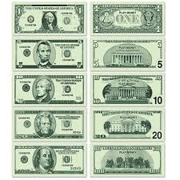
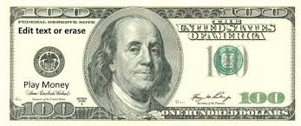
Qualified and Interested Activity: It takes four appointments for every successful “ask”
Hot pink hearts = Climate change
Light pink hearts = Arts, music, culture
Red hearts = Children’s education

Slide 20
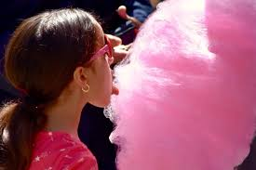

Cotton Candy
Zucchero filato
Shaer albanat
Zuckerwatte
Somsatang
Hattara
Pipi pipi
Mianhua tang
Shaer albanat
Permen kapas
Algodao doce
Algodon de azucar
Bombonski bombon

Slide 21


Cotton Candy Money
Crowd sourcing
Fun-runs
Golf tournaments
Galas are friend raisers, not fund raisers
“Buy a brick”

Slide 22
Poll: Asking for Money
Which fund-raising strategies are most effective?
Getting a meeting with James Farley, President of Leichtag Family Foundation
Helping your club sponsor a 10-K race
Asking your uncle to introduce you to his company’s owner
When you get the appointment, ask for a really big donation
Get a lot of auction items for a gala
Requiring your Board members to “Give” or “Get”
Writing a grant proposal to Microsoft Corp.

Slide 23
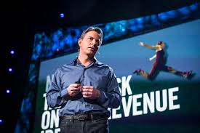
Dan Pallotta, TED Talk “Charity Case”

Slide 24
Dan Pallotta, TED Talk “Charity Case”
Separate Rules for Non-Profits and rest of the Economy
Discrimination in (5) areas
Compensation
Advertising and Marketing
Taking Risks in Pursuit of Innovation
Time
Profit to Attract Risk Capital

Slide 25
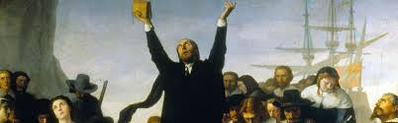
Dan Pallotta, TED Talk “Charity Case”
Overhead
Demonic label
Donor expectations, questions
Confusing morality with frugality
Epstein, Sackler, Metabolife, Mattel, Martin Shrekli, Mother Theresa
Puritanical tradition
Charity became Calvinist “penance” for having wealth
Hasn’t changed in 400 years
Notes:
Having

Slide 26
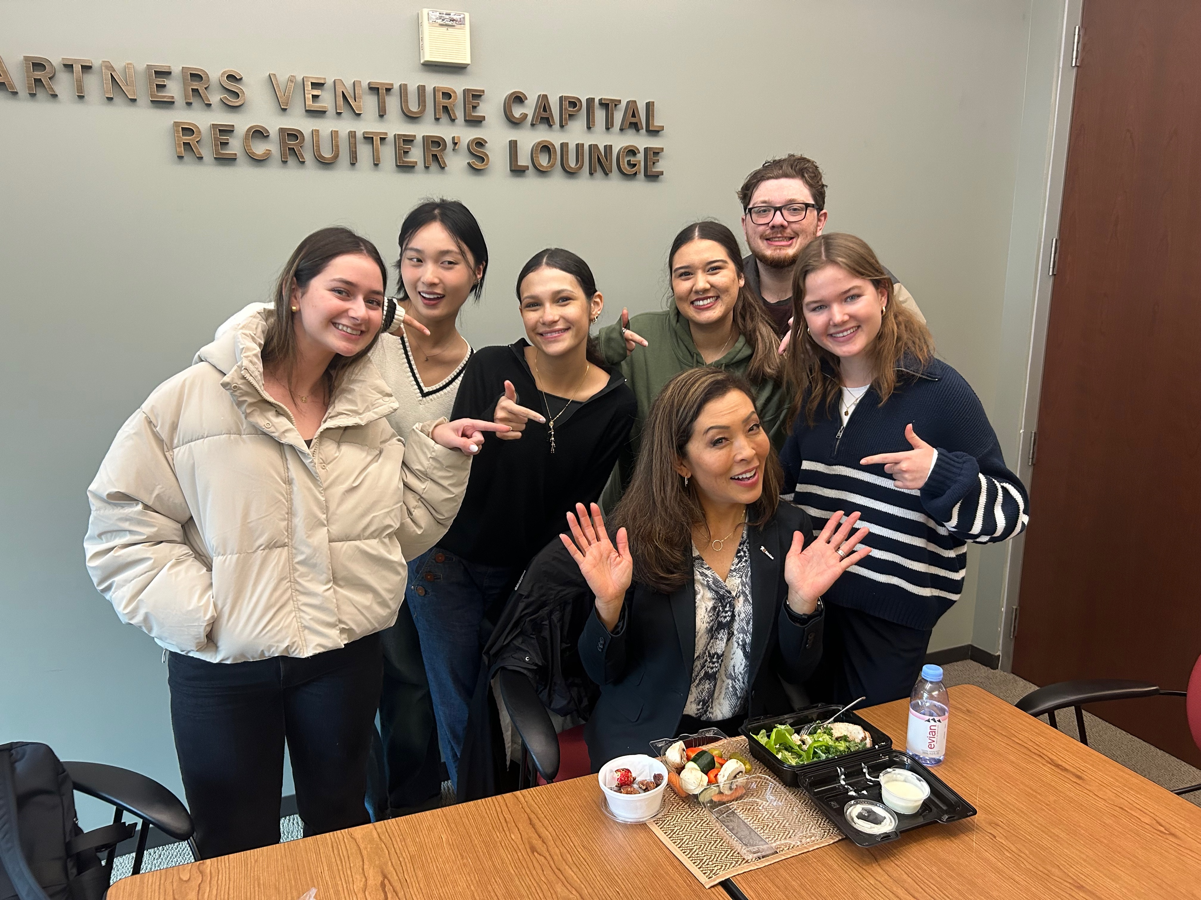
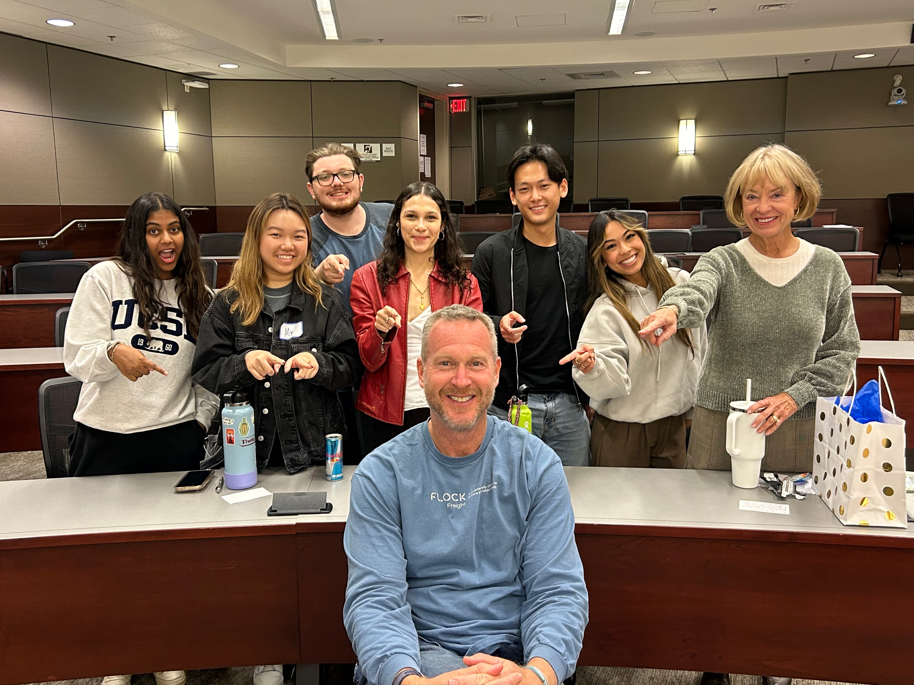
Our generation doesn’t want our epitaph to be,
“We kept charity overhead low.”
We want it to be, “We changed the world!”
Who cares about the overhead
if we are actually getting these problems solved?!

Slide 27

Activity: Help Each other Identify a Networking Target Share best practices
Organize around the lecture hall A-Z by last name
Just first letter, not perfect alphabetize
Count off in groups of 5
Find a place to talk (inside, outside, hallway, etc.)
Introduce yourselves
Discuss progress on your networking journey

Slide 28
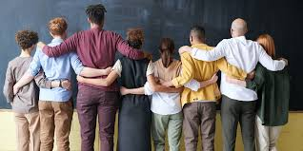
Where are you in the networking journey?
I have already conducted my interview
I have scheduled my appointment
Waiting for a response
I have a good idea who I want to target
I understand the assignment, but not yet started
Help!

Slide 29
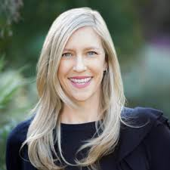

Guest Speaker Monday, 12 February Impact Investing
Heidi Krauel Patel
Rethink Impact
Student Hosts: Valerie Jubrail, Chloe Margulis, Pauline Wang

Slide 30
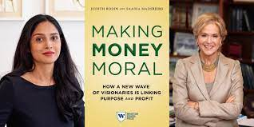
Assignments for Monday, 12 February
Melinda French Gates: ‘It’s time to change the face of power in venture capital’
What You Need to Know About Social-Impact Investing
The Rise Of ESG Investing
Making Money Moral essay

Slide 31
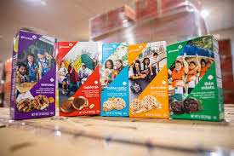
Drawing for Girl Scout Cookies

